Slide 1
An Optimal Algorithm for Maintaining Connectivity of Wireless Network on a Line
Shimin Li, Winona State University
Zhongjiang Yan, Northwestern Polytechnical University
Jingru Zhang, University of Texas-Rio Grande Valley

Slide 2
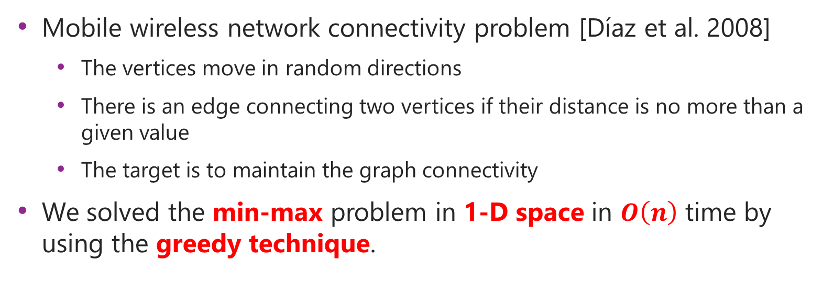
Previous Work and Our Results
Mobile wireless network connectivity problem [Díaz et al. 2008]
  The vertices move in random directions
  There is an edge connecting two vertices if their distance is no more than a given value
  The target is to maintain the graph connectivity
We solved the min-max problem in 1-D space in $O\left(n\right)$ time by using the greedy technique.

Slide 3

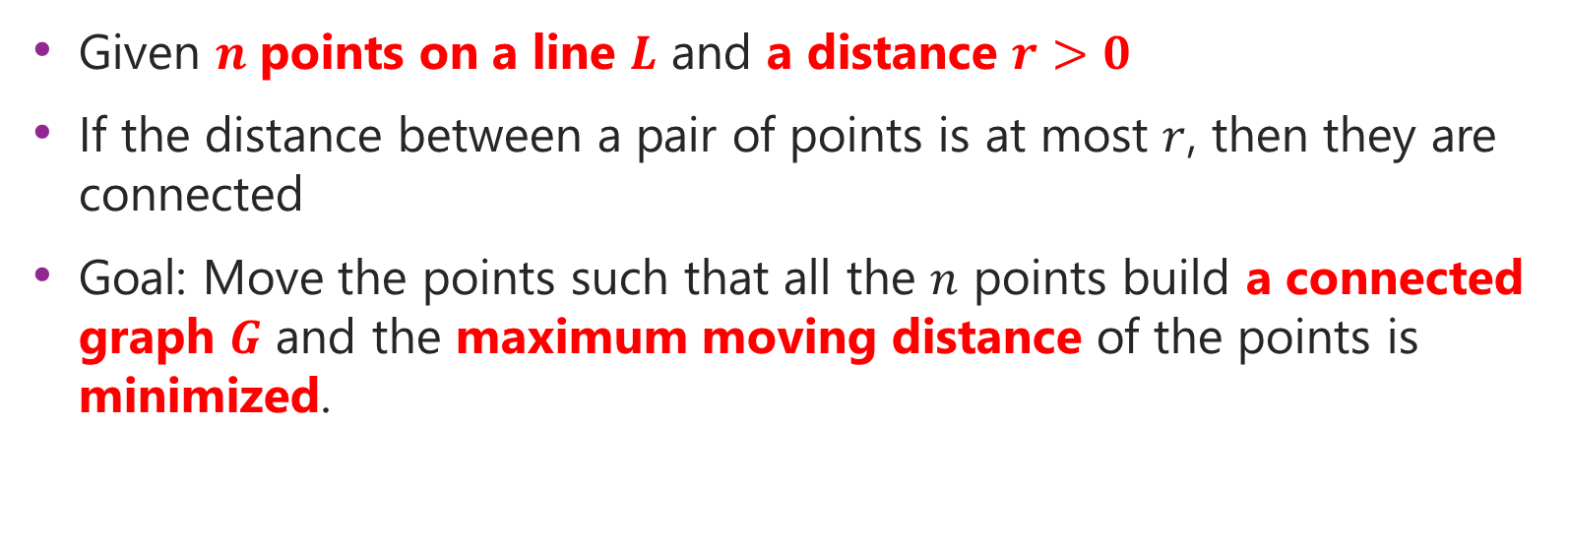
Problem Definition
Given $n$ points on a line $L$ and a distance $r>0$
If the distance between a pair of points is at most $r$, then they are connected
Goal: Move the points such that all the $n$ points build a connected graph $G$ and the maximum moving distance of the points is minimized.
$$L$$

Slide 4
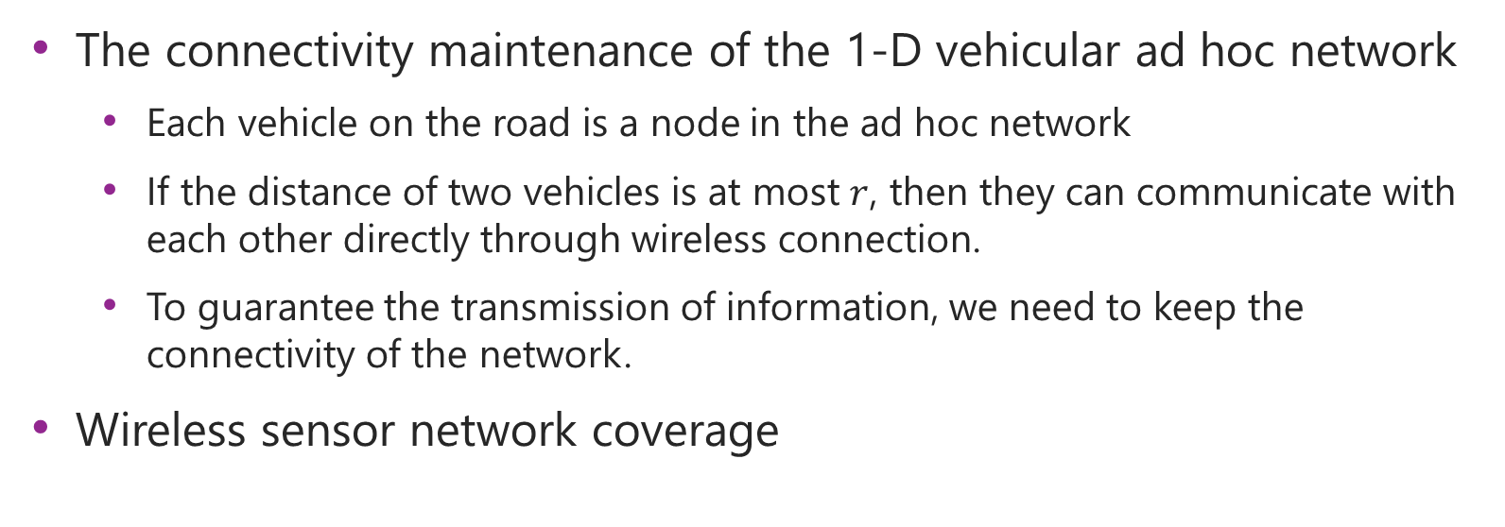
Applications
The connectivity maintenance of the 1-D vehicular ad hoc network
  Each vehicle on the road is a node in the ad hoc network
  If the distance of two vehicles is at most $r$, then they can communicate with each other directly through wireless connection.
  To guarantee the transmission of information, we need to keep the connectivity of the network.
Wireless sensor network coverage

Slide 5






Order Preserving Property
We don’t need to change the order of points in the input
$$i$$
$$j$$
$$j′$$
$$i′$$
$$j′$$
$$i′$$
$$j′$$
$$i′$$

Slide 6
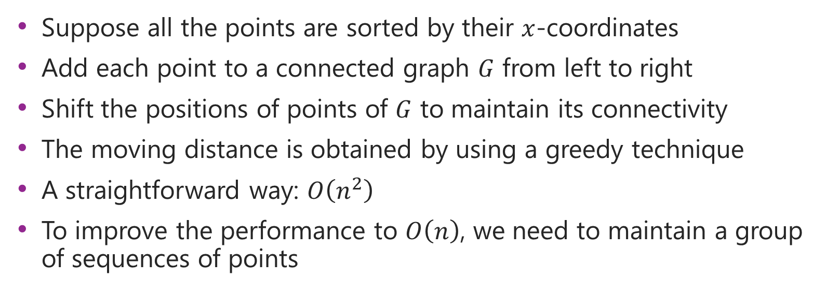
Main Idea
Suppose all the points are sorted by their $x$-coordinates
Add each point to a connected graph $G$ from left to right
Shift the positions of points of $G$ to maintain its connectivity
The moving distance is obtained by using a greedy technique
A straightforward way: $O\left(n^{2}\right)$
To improve the performance to $O\left(n\right)$, we need to maintain a group of sequences of points

Slide 7
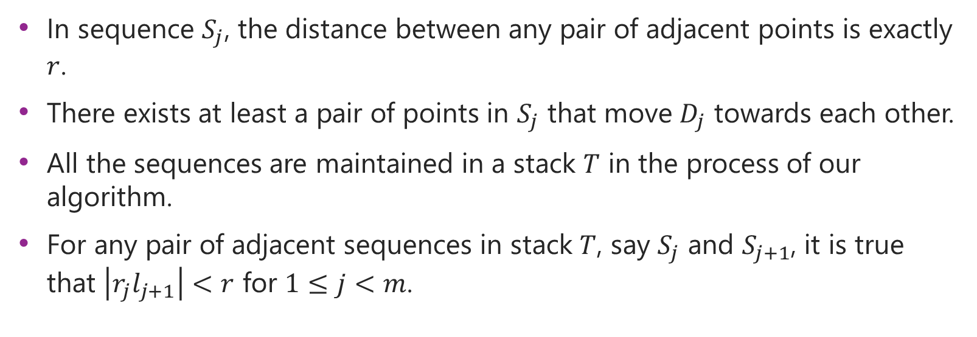
Properties of Sequence
In sequence $S_{j}$, the distance between any pair of adjacent points is exactly $r$.
There exists at least a pair of points in $S_{j}$ that move $D_{j}$ towards each other.
All the sequences are maintained in a stack $T$ in the process of our algorithm.
For any pair of adjacent sequences in stack $T$, say $S_{j}$ and $S_{j+1}$, it is true that $\left|r_{j}l_{j+1}\right|<r$ for $1≤j<m$.

Slide 8













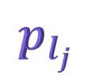

A Sequence Example
$$p_{l_{j}}$$
$$p_{a}$$
$$p_{l_{j}}$$
$$p_{b}$$
$$p_{d(r, j)}$$
$$p_{r_{j}}$$
$$D_{j}$$
$$D_{j}$$
$$S_{j}$$
$$p_{l_{j}}$$
$$p_{a}$$
$$p_{d(l, j)}$$
$$p_{b}$$
$$p_{d(r, j)}$$
$$p_{r_{j}}$$

Slide 9



The Initial Case
Add the only one point, $p_{1}$, into the sequence $S_{1}$
No need to move $p_{1}$
$$p_{1}$$
$$S_{1}$$

Slide 10
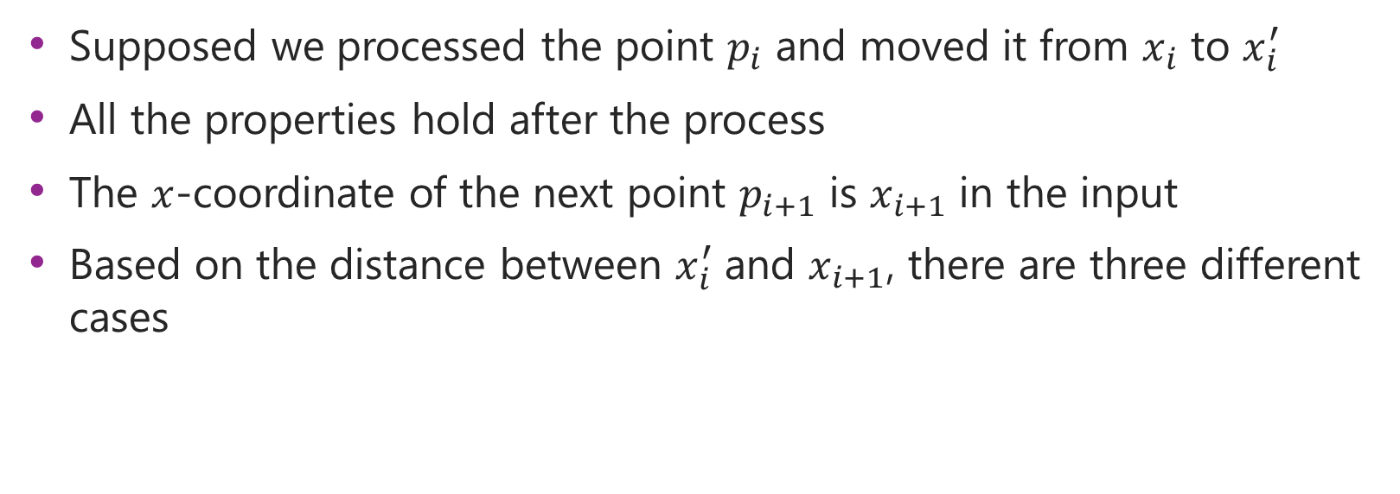
The General Case
Supposed we processed the point $p_{i}$ and moved it from $x_{i}$ to $x_{i}^{′}$
All the properties hold after the process
The $x$-coordinate of the next point $p_{i+1}$ is $x_{i+1}$ in the input
Based on the distance between $x_{i}^{′}$ and $x_{i+1}$, there are three different cases

Slide 11




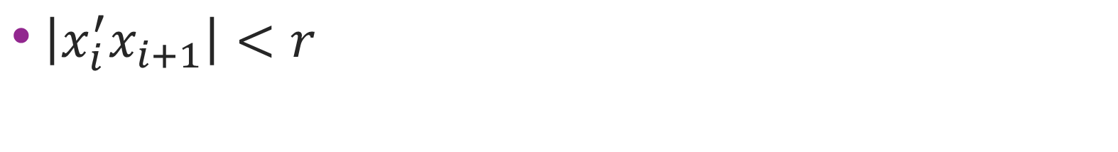






Case I
$\left|x_{i}^{′}x_{i+1}\right|<r$
$$x_{i}^{′}$$
$$x_{i+1}$$
$$⋯$$
$$r$$
$$p_{l_{m}}$$
$$p_{i−1}$$
$$p_{i}$$
$$p_{i+1}$$
$$S_{m}$$
$$S_{m+1}$$

Slide 12





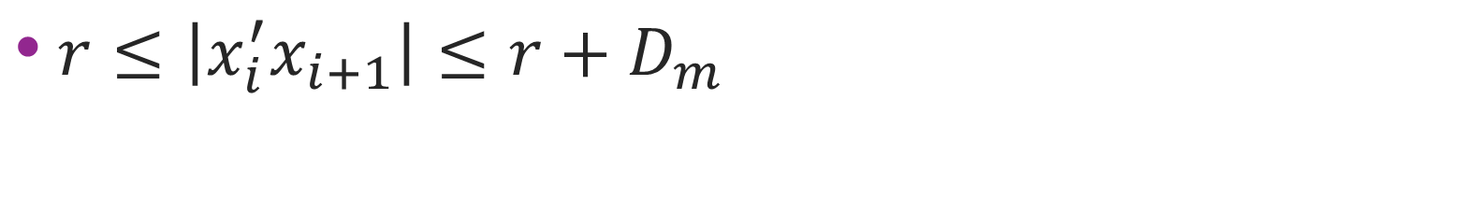






Case II
$r≤\left|x_{i}^{′}x_{i+1}\right|≤r+D_{m}$
$$x_{i}^{′}$$
$$x_{i+1}^{′}$$
$$x_{i+1}$$
$$⋯$$
$$r$$
$$r$$
$$p_{l_{m}}$$
$$p_{i−1}$$
$$p_{i}$$
$$p_{i+1}$$
$$S_{m}$$
$$S_{m}$$

Slide 13




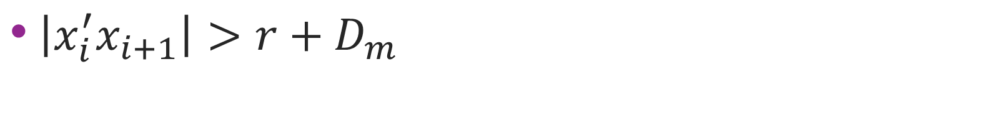






Case III
$\left|x_{i}^{′}x_{i+1}\right|>r+D_{m}$
$$x_{i}^{′}$$
$$x_{i+1}^{′}$$
$$x_{i+1}$$
$$⋯$$
$$r$$
$$r$$
$$p_{l_{m}}$$
$$p_{i−1}$$
$$p_{i}$$
$$p_{i+1}$$
$$S_{m}$$
$$S_{m}$$

Slide 14
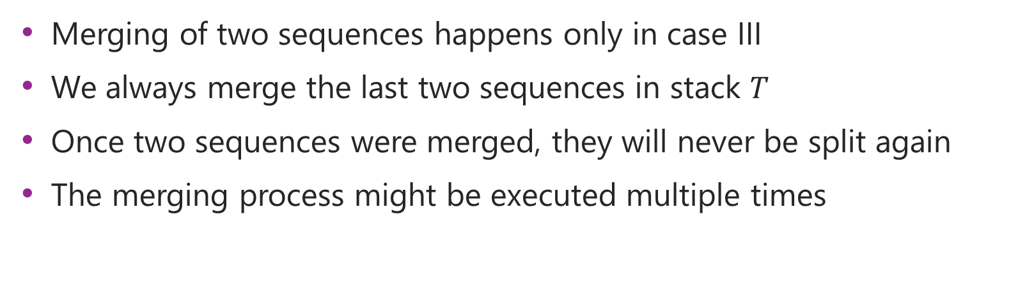
Merging Two Sequences
Merging of two sequences happens only in case III
We always merge the last two sequences in stack $T$
Once two sequences were merged, they will never be split again
The merging process might be executed multiple times

Slide 15




Merging Process
$$T$$
$$S_{m−1}$$
$$S_{m}$$
$$>r$$
$$<r$$

Slide 16



Merging Process (Cont.)
$$D_{m−1}$$
$$D_{m}$$
$$S_{m−1}$$
$$S_{m}$$

Slide 17

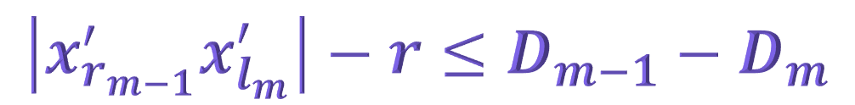
Merging Process Case I
$$\left|x_{r_{m−1}}^{′}x_{l_{m}}^{′}\right|−r≤D_{m−1}−D_{m}$$
$$S_{m−1}$$
$$S_{m}$$
$$r$$

Slide 18



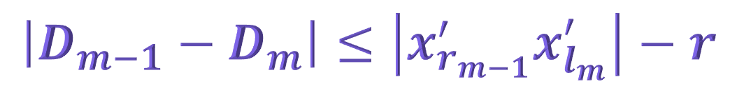
Merging Process Case II
$$\left|D_{m−1}−D_{m}\right|≤\left|x_{r_{m−1}}^{′}x_{l_{m}}^{′}\right|−r$$
$$S_{m−1}$$
$$S_{m}$$
$$∆_{m−1}$$
$$r$$
$$∆_{m}$$

Slide 19
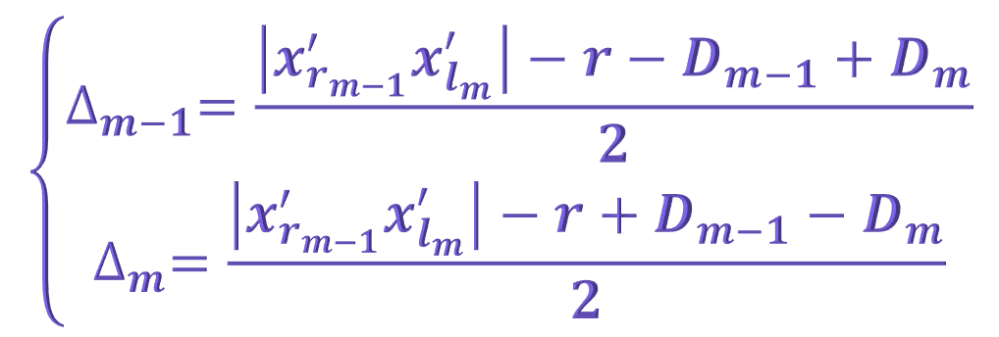
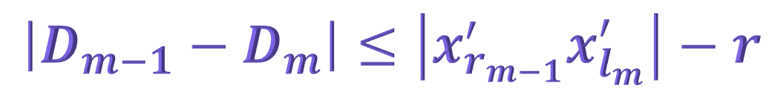
Merging Process Case II (Cont.)
$$\left|D_{m−1}−D_{m}\right|≤\left|x_{r_{m−1}}^{′}x_{l_{m}}^{′}\right|−r$$
$$\left\{\begin{aligned}∆_{m−1}=\frac{\left|x_{r_{m−1}}^{′}x_{l_{m}}^{′}\right|−r−D_{m−1}+D_{m}}{2} \\ ∆_{m}=\frac{\left|x_{r_{m−1}}^{′}x_{l_{m}}^{′}\right|−r+D_{m−1}−D_{m}}{2}\end{aligned}\right.$$

Slide 20

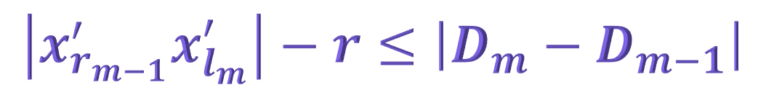
Merging Process Case III
$$\left|x_{r_{m−1}}^{′}x_{l_{m}}^{′}\right|−r≤\left|D_{m}−D_{m−1}\right|$$
$$S_{m−1}$$
$$S_{m}$$
$$r$$

Slide 21
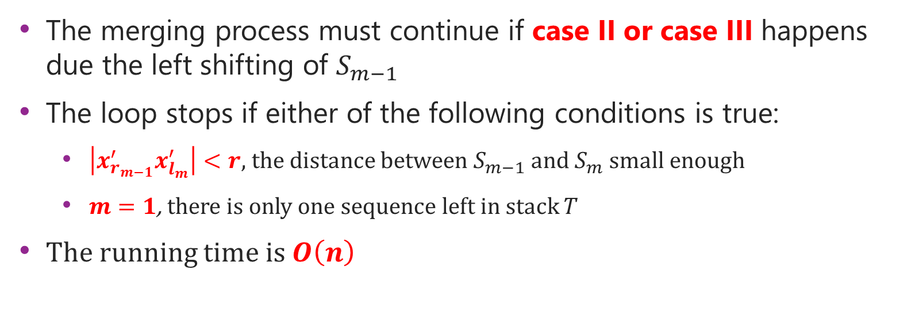
Stop Condition
The merging process must continue if case II or case III happens due the left shifting of $S_{m−1}$
The loop stops if either of the following conditions is true:
  $\left|x_{r_{m−1}}^{′}x_{l_{m}}^{′}\right|<r$, the distance between $S_{m−1}$ and $S_{m}$ small enough
  $m=1$, there is only one sequence left in stack $T$
The running time is $O\left(n\right)$

Slide 22
Thanks!

